Slide 1
Early disorders during pregnancy
Dr. Miguel Aguilera
HOD Obstetrics and Gynecology
SMAHS of The UTG

Slide 2
Miscarriage
Ectopic Pregnancy

Slide 3
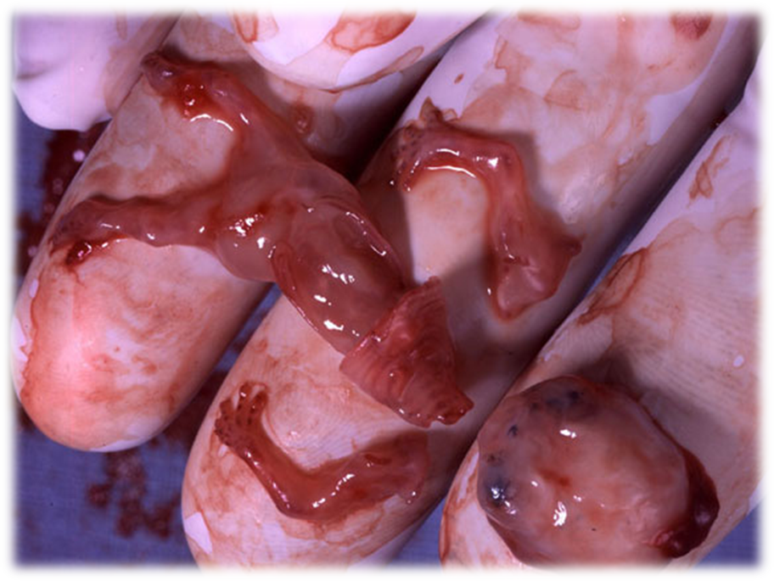
ABORTION

Slide 4

ABORTION. CONCEPT
Abortion is defined as the interruption of pregnancy before the perinatal period established by the World Health Organization (WHO), until the 22 weeks of pregnancy (154 days).
This definition is limited to the end of pregnancy before the 22 weeks from the last day of menstruation and when the fetus weighs less than 500g. It can be classified as early abortion when it occurs before the 12 weeks and as late abortion since the 13 week up to the 22.

Slide 5
ETIOLOGY
Ovular factors.
Local maternal factors.
General maternal factors.

Slide 6
ETIOLOGY. OVULAR FACTORS.
Defective ova: due to cromosomic defects of the embrio.
Trophoblast endocrine alterations.

Slide 7
ETIOLOGY. LOCAL MATERNAL FACTORS.
Inflammatory processes of the endometrium.
Uterine malformations.
Uterine hypoplasia.
Uterine tumors.
Cervical incompetence.

Slide 8
ETIOLOGY GENERAL MATERNAL FACTORS.
Infectious and parasitic diseases.
Citomegalo virus,Pseudomona,T.Pallidum
Exogenous intoxications.
Pb, Hg,Ar,morphine, alcaloids
Endocrine metabolic disorders.
Hepatic and renal deseases,obesity, DM, hipotiroidism
Lack of food.
F olic acid deficit
Trauma and emotional states.

Slide 9
ABORTION.CLINICAL PICTURE.
Threatened abortion.
Inevitable or imminent abortion.
Complete abortion.
Incomplete abortion.
Missed abortion.
Habitual abortion.
Septic abortion.

Slide 10
CLINICAL PICTURE.
THREATENED ABORTION.
Slight vaginal bleeding, bright red in colour.
Vaginal bleeding is almost always scanty and without pain.
Cervix is closed.

Slide 11
THREATENED ABORTION. DIFFERENTIAL DIAGNOSIS.
The differential diagnosis is made with:
Ectopic pregnancy.
Trophoblastic gestational neoplasia.
Vaginal ulcers.
Bleeding cervicitis.
Cervical erosions.
Cervical polyps.
Cervical uterine carcinoma.

Slide 12
THREATENED ABORTION.
OBSTETRIC MANAGEMENT.
An ultrasound should be performed to check for vitality and fetal characteristics.
The patient should rest in bed.
Neither hormonal drugs nor sedatives are used.
The pregnant woman and her family should be advised about the risk of pregnancy loss.

Slide 13
INEVITABLE OR IMMINENT ABORTION
Cervix dilatation.
The volume of blood loss is more severe, but there is no product of conception in the vagina.
Colicky pains in the inferior hemi abdomen, with increased sensitivity in the epigastrium.
After being confirmed that pregnancy cannot reach fetal viability due to dilation of the cervix and severe hemorrhage, uterine evacuation and cavity aspiration will be performed.

Slide 14
INCOMPLETE ABORTION
Incomplete abortion is defined when partial tissue of pregnancy is expelled before the 22 weeks´ gestational pregnancy. The placenta and fetus can be expelled together, but after this time, they are usually expelled separately.

Slide 15
INCOMPLETE ABORTION.
CLINICAL PICTURE.
It is characterized by vaginal bleeding, colicky pain and the presence of expelled tissue.
On physical examination the cervix is effaced o dilated, bleeding is observed and, sometimes clots have been expelled.
In patients, after having an incomplete abortion, a careful suction curettage should be performed as soon as possible, to avoid possible complications.
Patients who are rhesus negative should be given a prophylactic injection of anti- D immunoglobulin.

Slide 16
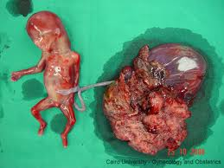
COMPLETE ABORTION
All products of conception have been expelled from the uterus.

Slide 17
COMPLETE ABORTION.
CLINICAL PICTURE.
The cervix is closed
The bleeding is slight and gradually diminishes.
The pain ceases.
The uterus is slightly larger than normal.

Slide 18
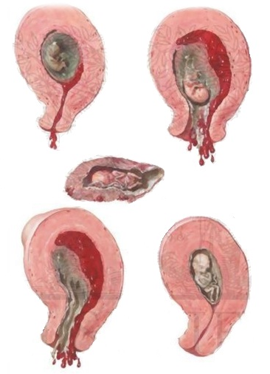
MISSED ABORTION
Retention of dead products of conception.

Slide 19
MISSED ABORTION.
CLINICAL PICTURES.
The patient usually has a history of threatened abortion which settles down, but she complains of dirty, brown discharge which persists.
Regression of pregnancy symptoms as nausea, vomiting and breast symptoms.
The abdomen does not increase and may even decrease in size.
The uterus fails to grow and becomes firmer and the cervix is closed.
The foetal heart sounds cannot be heard.

Slide 20
MISSED ABORTION. COMPLICATIONS.
Disseminated intravascular coagulation (DIC) may occur if the dead conceptus is retained for more than 4 weeks.
Superadded infection.

Slide 21
HABITUAL ABORTION (RECURRENT).
This type of abortion is characterized by three or more successive spontaneous abortions.
It is more frequent during the first trimester of early pregnancy.

Slide 22
HABITUAL ABORTION (RECURRENT). ETIOLOGY.
Not known.
Uterine malformations or abnormality.
Cervical incompetence.
Chromosome abnormality.
Endometrial infection.
Endocrine dysfuntion.
Systemic disease.

Slide 23
SEPTIC ABORTION
Any time there is infection related to abortion, doctors should think about the possibility that it results from manipulation or abortive maneuver.
The infection usually starts in the uterus (as endometritis, involving the endometrium and retained products of conception) and can go to parametritis, peritonitis, septicemia and septic shock).
The most common complication is pelvic inflammatory disease. (PID).

Slide 24
SEPTIC ABORTION. MICROBIOLOGY.
Anaerobic streptococci.
E.Coli.
Staphylococci.

Slide 25
SEPTIC ABORTION.
CLINICAL PICTURES.
Tachycardia.
Pulse rate of more than 120 beats per minute.
Tender lower abdomen.
Vaginal examinations shows a boggy, tender uterus with evidence of extra uterine spread.

Slide 26
ABORTION. INVESTIGATIONS
Human chorionic gonadotropin dosification.
Dosification of human placental lactogen.
Estrogens.
Alphafetoprotein.
Leukocyte alkaline phosphatase.
Ultrasonography.

Slide 27
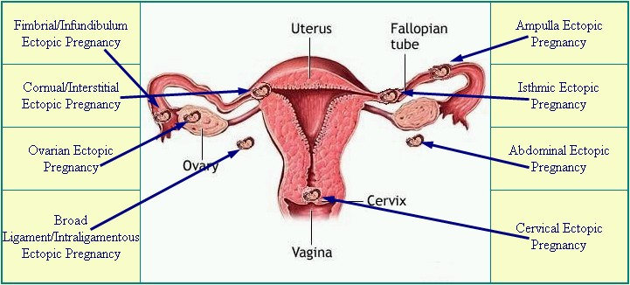
ECTOPIC PREGNANCY

Slide 28
ECTOPIC PREGNANCY
Ectopic pregnancy is established when the blastocyte is implanted out of the uterine cavity (ectos-out and topos-place).
Ectopic means "out of place.“ In an ectopic pregnancy, a fertilized egg has implanted outside the uterus.

Slide 29
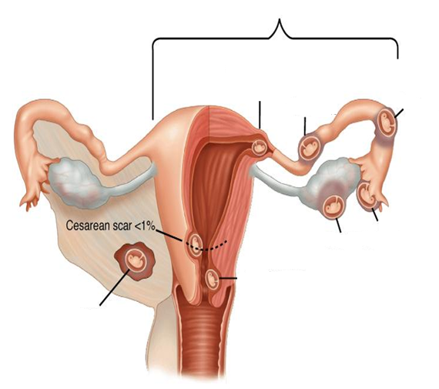
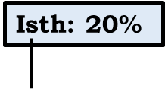
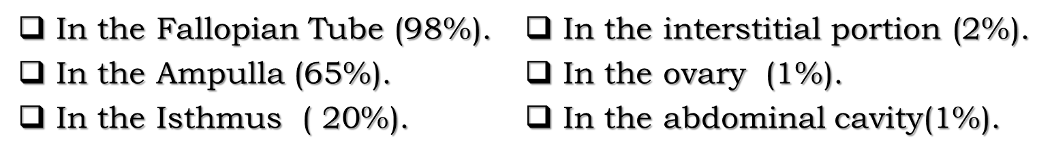
SITES OF ECTOPIC GESTATION IMPLANTATION.
Tubal: 98 %
Int. P.: 1 %
Amp.: 65 %
Ovarian: 1 %
Abdominal: 1 %

Slide 30


ECTOPIC PREGNANCY. ETIOLOGY.
The etiology of ectopic gestation is not known.

Slide 31
ECTOPIC PREGNANCY.
RISK FACTORS.
Infections caused by Chlamydia Trachomatis or Neisseria Gonorrhea.
Tobacco.
Pelvic or abdominal surgeries.
Contraceptive methods.
Maternal age.
Assisted reproduction.
Surgery on the Fallopian Tubes.
Previous ectopic pregnancy.

Slide 32
ECTOPIC PREGNANCY.
SYMPTOMS AND SIGNS.
Abdominal pain.
Amenorrhoea.
Adnexal tenderness.
Abdominal tenderness.
Vaginal bleeding.
Adnexal mass.

Slide 33
UNCOMPLICATED TUBAL PREGNANCY. CLINICAL PICTURES.
Subjective symptoms of early pregnancy.
Amenorrhea.
Biological tests are positive.
Mild malaise or abdominal heaviness.
Sometimes a limited small ovoidal tumor is palpated.

Slide 34
COMPLICATED ECTOPIC PREGNANCY. TYPES.
With hemodynamic stability.
With signs of hemodynamic impairment or shock.

Slide 35
HEMODYNAMIC STABILITY
Pain is more severe and can move to any other place, through the entire abdomen and shoulder.
Usually bleeding does not change.
On palpation the adnexal tumor is very painful.
On examination, the lower part of the pouch of Douglas can be domed or very painful.
In case of suspected rupture, it should not be confirmed by puncture of the pouch of Douglas or the abdomen.
Signs of peritoneal and intestinal irritation due to free blood in the peritoneum can be observed.
Confirmative or therapeutic laparoscopy or conventional laparotomy should be performed.

Slide 36
HEMODYNAMIC IMPAIRMENT
Signs of shock such as: sweating, paleness, tachycardia, coldness and hypotension will be observed.
The diagnosis of hemoperitoneum is made by puncture in the lower part of the pouch of Douglas when drawing blood that does not coagulate; volume will be replaced as needed and is treated surgically by means of urgent laparotomy.

Slide 37
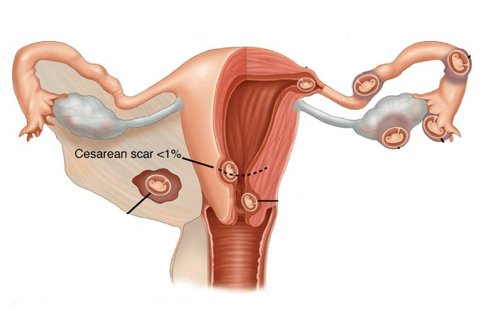
INTERSTITIAL ECTOPIC PREGNANCY
It is the most dangerous localization due to the profuse hemorrhage it causes.
Interstitial

Slide 38
ABDOMINAL ECTOPIC PREGNANCY
Laparotomy surgery should be performed by the most experienced surgeon and anesthesiologist. Usually, it takes longer gestational age than the ones located in the fallopian tubes.
Abdominal

Slide 39
CERVICAL ECTOPIC PREGNANCY
It is not very frequent and is treated with abdominal total hysterectomy.
Cervical

Slide 40
OVARIC ECTOPIC PREGNANCY
Sometimes affects only a part of the ovary, so it can be preserved , although the tumor dried up.
Ovarian

Slide 41
ECTOPIC PREGNANCY.
DIFFERENTIAL DIAGNOSIS.
Abortion of any type.
Persistent and hemorrhagic folicle.
Cyst of the corpus luteum.
Acute pelvic inflammation.
Endometriosis.
Acute appendicitis.
Complicated myoma.

Slide 42
ECTOPIC PREGNANCY.
DIAGNOSTIC TESTS.
Non invasive:
  Chorionic gonadotropine dosification.
  Ultrasound (abdominal and vaginal).
Invasive:
  Puncture of the lower part of the pouch of Douglas.
  Abdominal puncture.
  Diagnostic curettage.
  Laparoscopy.

